Slide 1
Customer Segmentation
Wireframe Documentation

Slide 2
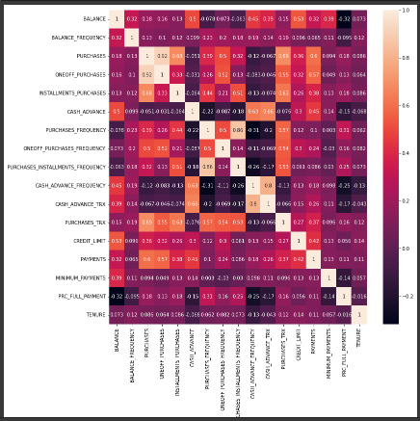
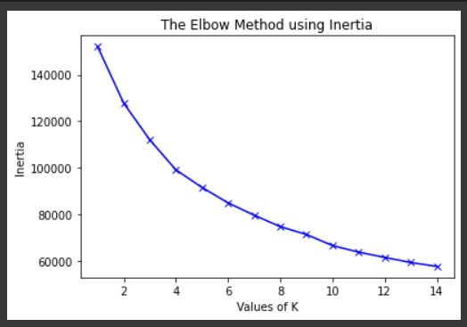
Modeling
: -
1. First we found out correlation between different variables .
2. We used ‘Elbow’ method to find the optimum value of k in k means clustering .

Slide 3
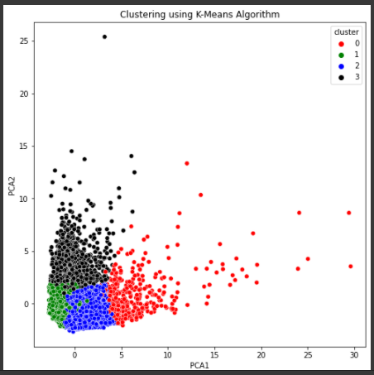
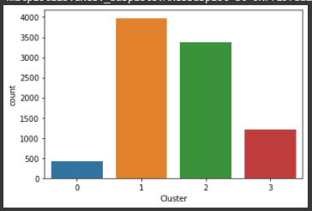
3. We divided our customers into four different clusters .
4. Comparison between the number customers representing each group.

Slide 4
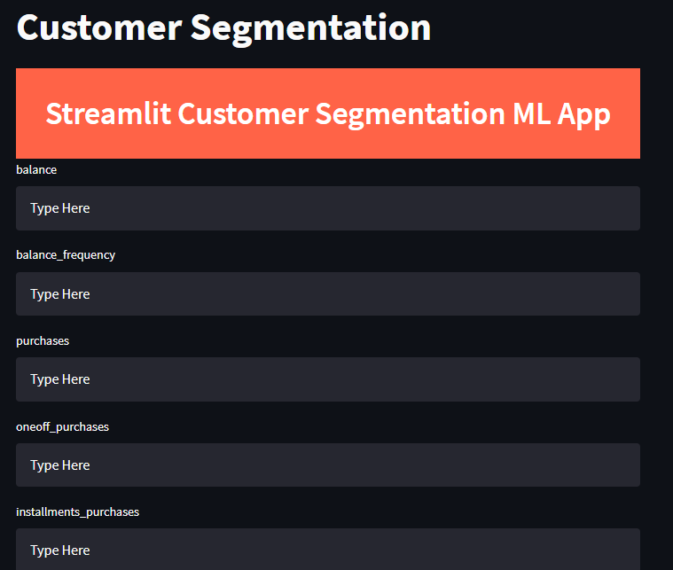
About Page
In the following model we use streamlit app to collect data (17 different variables ) from each customer and predict which group they belong (group 1,2,3,4) as shown below:

Slide 5
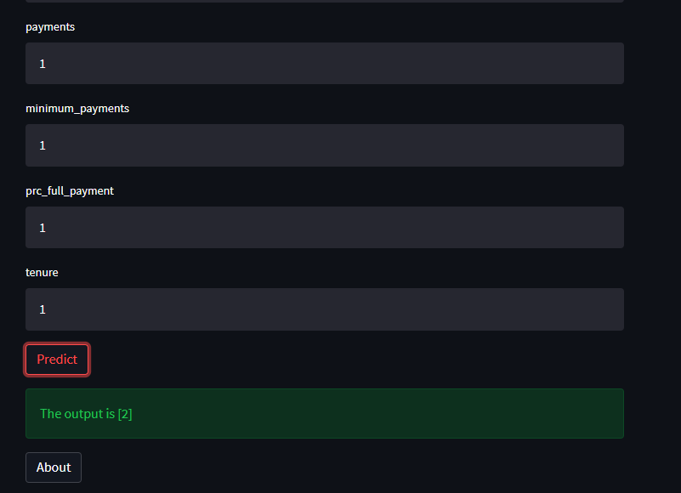
In this Page, we will showcase the predicted output.

